Slide 1

Employee Attrition - Data Analysis Report

Slide 2
Steven Williams- CEO Jamie Caulfield - CFO
Audience
Documentation
Link to Github:
https://github.com/feby-thomas/DSRepo/tree/main/DS6306/Case%20Study2
Link to KnitFile :
https://github.com/feby-thomas/DSRepo/tree/main/DS6306/Case%20Study2/Case_Study2_Code_files/figure-html
Youtube Link: https://youtu.be/YoO2WOJICOI
Prediction Attrition & Salary
https://github.com/feby-thomas/DSRepo/tree/main/DS6306/Case%20Study2

Slide 3
Key Data Analysis Findings
Employee Attrition - Exploratory Data Analysis
Exploring correlations impacting Attritions
Attrition - Data Modeling
Attrition - Prediction Models
Salary – Data Prediction Models

Slide 4
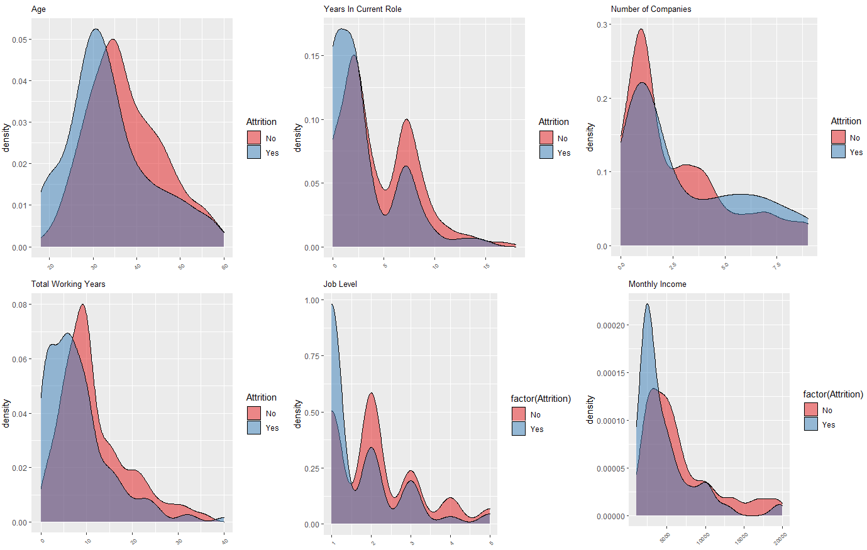
Employee Attrition - Exploratory Data Analysis
Data Inferences
Attrition is prominent in the initial years (<5) if the employee continue in the same role
Attrition is visible at the early stage of the career(5 -10) year gap , or at the younger ages.
From the job level, its evident that the junior job level is high impact on the attrition.
Monthly income is low for the attrition employees, which also corroborates the assumption that attrition rate high among entry/ junior employees

Slide 5
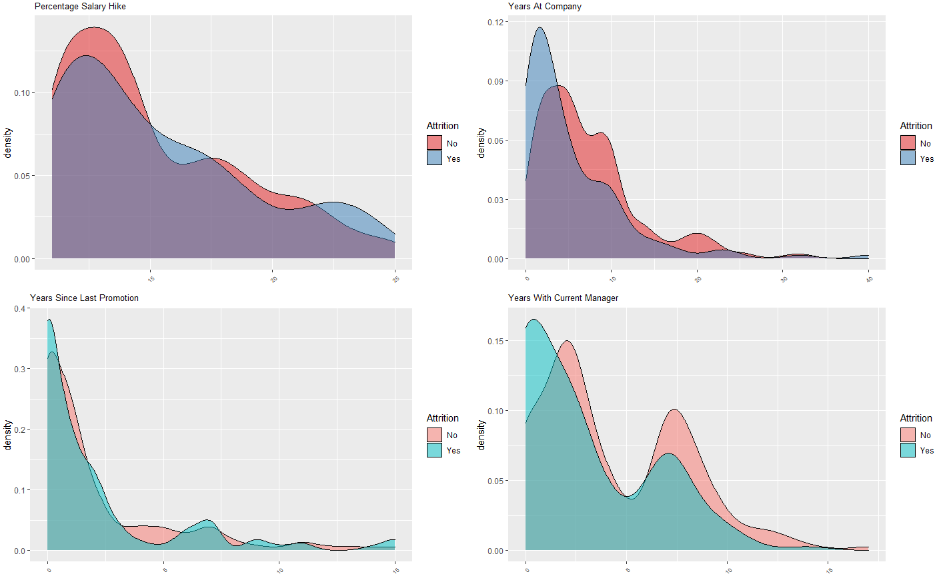
Employee Attrition - Exploratory Data Analysis
Data Inferences
Percent salary hike is linked with attrition, Lower the hike % higher the attritions %
Attrition % is lower, sharply reduces after initial 10 years at the company
Long periods working under the same manger shows lower attrition percentages.

Slide 6
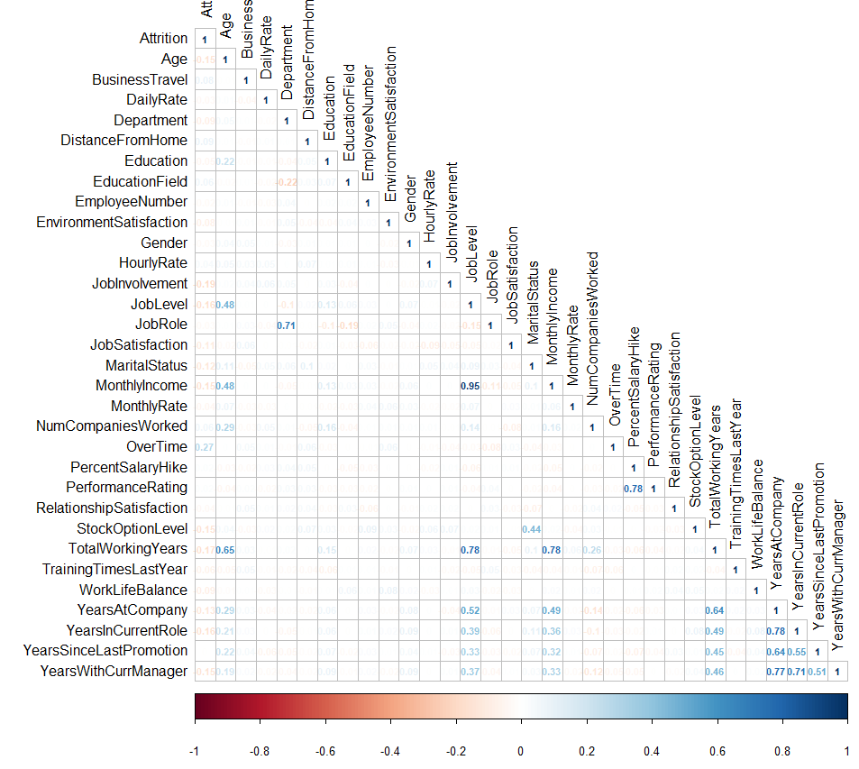
Exploring data correlations with Attritions
Data Inferences
Correlation plot depicts the correlation coefficients against all the other explanatory variables with target variable
Higher coefficients , +/- indicates the variables have some correlation w.r.t Attrition variable .

Slide 7
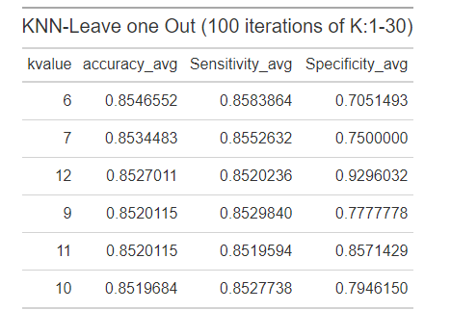
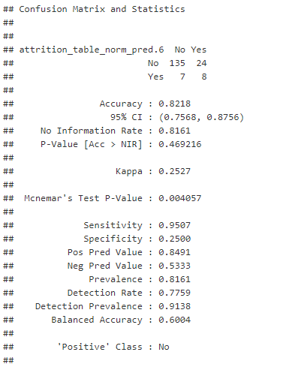
Attrition - Data Modeling & Prediction
Data Inferences
KNN Leave out modeling, with K= 6 is having highest accuracy , K= 12 which is having higher specificity numbers.
KNN- TT model with K= 12 is gives the Accuracy (0.81 ), Sensitivity (0.9437) and Specificity (0.2188)
Prediction for 300 data observation, Number of Attrition (Yes = 6), No =294 for KNN = 6

Slide 8
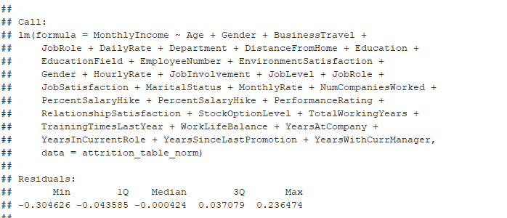

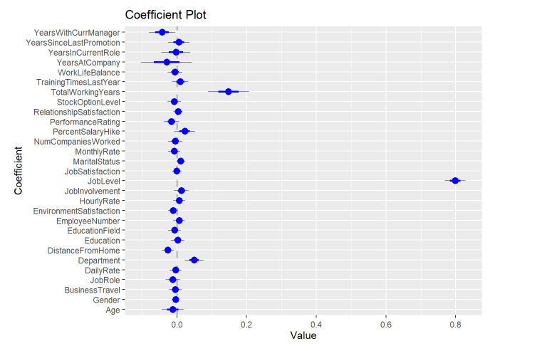
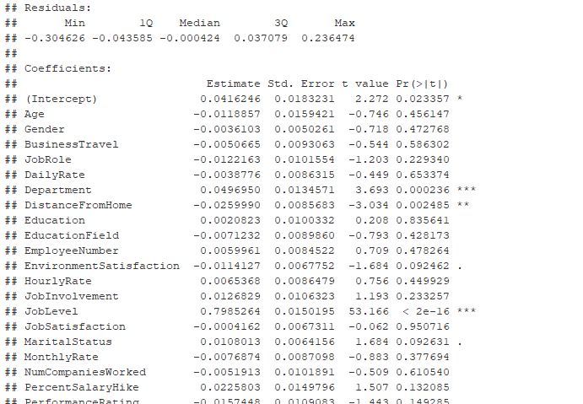
Salary – Data Prediction Models
Data Inferences
Adopted multiple liner regression model to predict the salary details of the 300 data points.
Residual stand error is around 0.07208 with 840 degrees of freedom
P value < 0.05

